Slide 1
Exception rules
29 August 2011
Notes:
Exception rules - <number>
Guidewire training materials contain Guidewire proprietary information that is subject to confidentiality and non-disclosure agreements. You agree to use the information in this manual solely for the purpose of training to implement Guidewire software solutions. You also agree not to disclose the information in this manual to third parties or copy this manual without prior written consent from Guidewire. Guidewire training may be given only by Guidewire employees or certified Guidewire partners under the appropriate agreement with Guidewire.

Slide 2
Lesson objectives
By the end of this lesson, you should be able to:
  Explain exception rule processing
  Create activity escalation rules
  Create claim exception rules
  Test exception rules
Notes:
Exception rules - <number>

Slide 3
Lesson outline
Exception rules
Activity escalation rules
Claim exception rules
Running exception rules
Notes:
Exception rules - <number>

Slide 4

Exception rules
Identify objects that need attention, such as:
  Work that has not been completed on time
  Unusual reserve values or changes in values
Provide appropriate action, such as:
  Creating additional activities, often for a supervisor
  Flagging a claim
Executed on a scheduled basis, for example once a day
Notes:
Exception rules - <number>
This lesson focuses on two types of exception rules: claim exception and activity escalation rules. A claim exception rule or activity escalation rule identifies objects that need attention and performs an appropriate action. The two most common actions are creating an activity or flagging a claim, both discussed in this section.

Slide 5
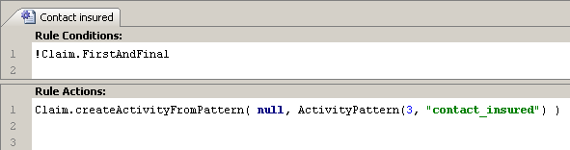
Review: Creating activities through Gosu
Syntax:
  Claim.createActivityFromPattern (
  RelatedExposure, ActivityPattern)
  Claim is the current claim
  RelatedExposure is null (for claim-level activities) or the related Exposure object (for exposure-level activities)
  ActivityPattern specifies the activity pattern
Notes:
Exception rules - <number>
The example above is a pre-update rule which creates an activity for the Claim object using the "contact_insured" activity pattern. This activity is a claim-level activity. It is not associated to any exposure.

Slide 6
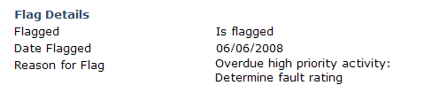
Flagging claims
Syntax
  Claim.setFlag (flaggedReason)
  Claim is the current claim
  flaggedReason is a string identifying the concern
Notes:
Exception rules - <number>
A common method used in exception rules is flagging a claim with setFlag(). In this example, the current object is an activity and the setFlag() method is used to flag the associated claim as needing attention. The result of flagging a claim is shown on the next slide.
When a claim is flagged, the flag icon appears in the info bar. Also, the claim’s loss details screen contains a flag details section, which identifies when the claim was flagged and why.
The following list describes the attributes that you can use with flagged claims.
Claim.CurrentlyFlagged tells if the claim currently has the flag set
Claim.Flagged indicates the flagged status of a claim:
isFlagged
neverFlagged
wasFlagged
Claim.FlaggedReason provides a reason for the flag to help the adjuster understand the nature of the exception. You set this value when setting the flag. This will be a concatenation of all reasons the claim has been flagged since the last time the flag was unset.
Claim.FlaggedDate indicates the date on which a flag was originally set.
While it is possible to modify some of these fields, the best practice is to use the setter and let the system set the values appropriately.
If desired, you also can configure the tooltip for the flag to display the value for FlaggedReason.
Because it is expected that only the supervisor will do this once the issue causing the flag has been resolved, there is no method for removing flags.
When the supervisor clears the flag, the date is set to null.

Slide 7
Lesson outline
Exception rules
Activity escalation rules
Claim exception rules
Running exception rules
Notes:
Exception rules - <number>

Slide 8
Activity escalation rule set
When scheduled to run, will be executed against activities which:
  Have an escalation date on or before the current date
  AND
  Have not yet been escalated
Notes:
Exception rules - <number>
The simplest approach to escalated activities is to create an activity for the group supervisor to check on why the work is not yet complete. You may also want to flag the claim.
Once an activity has been escalated, the activity escalation rule set will not be run against the activity again.

Slide 9
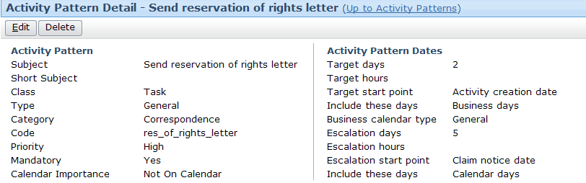
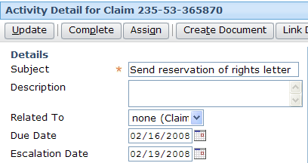
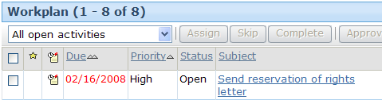
Activity escalation points
Claim notice: 02/14/2009 escalation days: 5 Escalate on: 02/19/2009
Notes:
Exception rules - <number>
Recall that the activity pattern specifies the point at which an activity created from that pattern is to be escalated. The escalation point is expressed as a number of days or hours after a specified event, such as the claim notice date.
In the ClaimCenter base application, the only behavior assigned to escalated activities is the way in which they appear in activity lists. (The "escalated" icon appears in the escalated column for activities that have been escalated.)

Slide 10
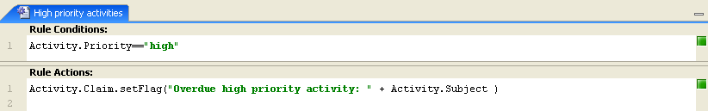
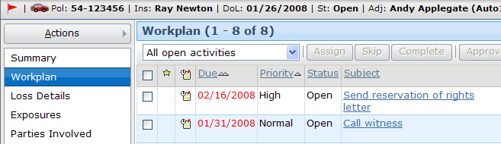
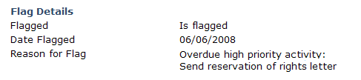
Example activity escalation rule
Notes:
Exception rules - <number>
The top screenshot shows the base application's "High priority activity" escalation rule. It states if an activity is past its escalation date and is of priority “high”, then the claim should be flagged with a reason of "Overdue high priority activity: " plus the activity’s subject.
The middle screenshot shows a claim with a “Send reservation of rights letter" activity which is of high priority and set for escalation on 2/19/2009. On 2/19/2009, the High priority activities escalation rule flagged the claim.
The bottom screenshot shows the flag details, which appear as part of the claim’s Loss Details screen.

Slide 11
Lesson outline
Exception rules
Activity escalation rules
Claim exception rules
Running exception rules
Notes:
Exception rules - <number>

Slide 12
Claim exception rule set
One rule set run on two different batch schedules:
  Claims changed in a significant way
    Examples: claim basics, exposures, financial transactions
    Does not include adding notes or documents
  Idle claims
    Claims not processed by claim exception rules for a defined time period
    Set time period with the IdleClaimThresholdDays configuration parameter
Notes:
Exception rules - <number>
There are two batch schedules for claims:
Changed claims: The claim must have changed in some significant way since the last time exception checking was run. Significant changes include editing the claim basics, adding or editing an exposure, and adding or changing a financial transaction. (Adding notes or documents, for example, is not considered a significant change because exception rules would not normally evaluate the content of a new note or document.)
Idle claims: ClaimCenter evaluates any claim that has not been processed as a changed claim for the number of days defined by the IdleClaimThresholdDays configuration parameter in config.xml.

Slide 13
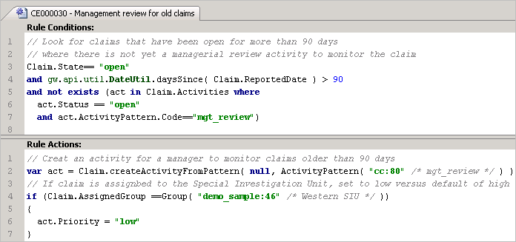
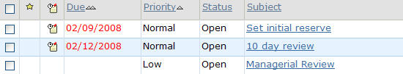
Claim exception rule - example
Notes:
Exception rules - <number>
This rule runs for all claims that are open, are older than 90 days, and do not have an open managerial review activity. For each claim that meets these conditions, the rule creates a managerial review activity. If the assigned group for the claim is the Western SIU group, then the default priority (“high”) for the activity pattern is overridden to be “low”.

Slide 14
Dynamically Setting Activity Fields
Even though an activity is created from an activity pattern, it is possible to set values to reflect specific conditions
Notes:
Exception rules - <number>
If a rule creates an object, typically an activity, then you can check for the existence of the object in the rule’s conditions to avoid executing the rule’s actions repeatedly.
In many cases, the activity is to resolve the issue identified in the exception rule’s conditions or to monitor the situation until it has been resolved. In these cases, you should also verify that the previously created activity is still open. In the example above, the goal is to ensure that there is an open activity for the manager to monitor the claim. Therefore, the rule conditions check whether a managerial review activity exists and is still open.

Slide 15
Preventing repeated actions
Claim exception rules run against a claim repeatedly
  You may want a rule’s actions to only happen once or if needed
Examples
  Only flag a claim once
  Only create an activity once
  Create an activity only if there isn't an open one already existing
Two approaches:
  Looking for an existing object
  Using history events
Notes:
Exception rules - <number>

Slide 16
Preventing repeated actions using objects
If the rule’s action creates an object, check for the existence of the object
For an activity, consider checking that the activity is open
Notes:
Exception rules - <number>
If a rule creates an object, typically an activity, then you can check for the existence of the object in the rule’s conditions to avoid executing the rule’s actions repeatedly.
In many cases, the activity is to resolve the issue identified in the exception rule’s conditions or to monitor the situation until it has been resolved. In these cases, you should also verify that the previously created activity is still open. In the example above, the goal is to ensure that there is an open activity for the manager to monitor the claim. Therefore, the rule conditions check whether a managerial review activity exists and is still open.

Slide 17
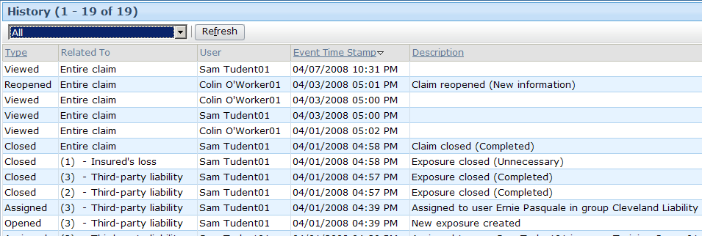
Review: Claim history
A record of significant events in claim's life cycle
  ClaimCenter automatically writes certain events
  Custom events can also be added via business rules
If the rule does not create an object, use the claim history to record that the rule has already executed
Notes:
Exception rules - <number>

Slide 18
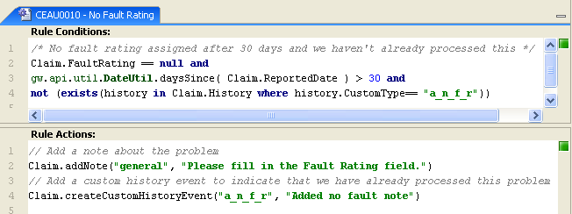
Preventing repeated actions using claim history
In the rule action, record a custom history event
In the rule condition, check whether the custom history event already exists
Notes:
Exception rules - <number>
In this example, you could also check for the existence of a note with the specified text.

Slide 19
Lesson outline
Exception rules
Activity escalation rules
Claim exception rules
Running exception rules
Notes:
Exception rules - <number>

Slide 20
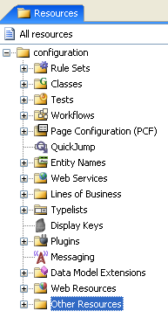
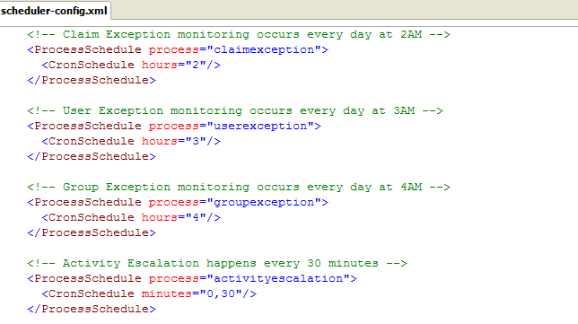

Scheduling exception rules
Scheduler-config.xml
Notes:
Exception rules - <number>
You use the scheduler-config.xml file to schedule when and how often the exception rules are run on a regular basis. You should access this file from the Guidewire Studio Resources pane under configuration → Other Resources. Generally, the amount of time between when a batch process wakes is specified in hours as opposed to minutes. This is because some batch process can require a lot of resources on a server so you want them to wake infrequently or when the server is less taxed — for example, late at night or very early in the morning.
The CronSchedule tag describes when the process is run. It contains attributes that specify the exact timing, such as such as once an hour or every night. You can use a combination of one or more of the following attributes: seconds, minutes, hours, dayofmonth, month, and dayofweek. You also can use the following special characters:
* for all values
, to separate additional values such as dayofweek=“MON,WED,FRI”
/ to specify increments such as minutes=“0/15” means start at minute zero and run every 15 minutes
L to specify the last day of a week or month
See the ClaimCenter System Administration Guide for more information about specifying schedules.

Slide 21
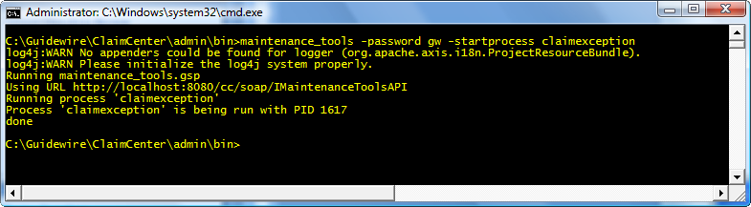
Testing exception rules
Syntax:
  maintenance_tools –password password –startprocess process
    password is the user’s password
      If user name not entered, defaults to su
    Process specifies a process that runs exception rules:
      activityescalation
      claimexception
      idleclaimexception
Notes:
Exception rules - <number>
When creating or modifying exception rules, you need to test your new rules without waiting until the scheduled batch process. The maintenance_tools command-line utility enables you to run various batch processes, including the following processes that run the exception rules:
activityescalation: runs the activity escalation rules
claimexception: runs the claim exception rules on changed claims
idleclaimexception: runs the claim exception rules on idle claims
In training, use "gw" as the administrative password.
For more information about the maintenance_tools command, see the ClaimCenter System Administration Guide.

Slide 22
Lesson objectives review
You should now be able to:
  Explain exception rule processing
  Create activity escalation rules
  Create claim exception rules
  Test exception rules
Notes:
Exception rules - <number>

Slide 23
Review questions
What triggers the running of exception rules?
Which activities are processed by the activity escalation rules?
Which claims are processed by the claim exception rules?
How can a claim’s history be used to prevent an action from executing more than once?
Notes:
Exception rules - <number>
Answers
1. exception rules are triggered by scheduled batch processes.
2. The activity must have an escalation date which has already passed and the activity itself has not yet been escalated.
3. The claim exception rules process either the claims that have changed or the claims that have been idle for the number of days specified by the IdleClaimThresholdDays configuration parameter. The batch process used to run the exception rules determines which group of claims is processed.
4. If an action is to be executed only once, you can check to see if a custom event for the action has been written to the history and, if not, then execute the action and write a custom event to the claim history.

Slide 24
Notices
Copyright © 2001-2011 Guidewire Software, Inc. All Rights Reserved.
Guidewire, Guidewire Software, Guidewire ClaimCenter, Guidewire PolicyCenter, Guidewire BillingCenter, Guidewire Reinsurance Management, Guidewire ContactManager, Guidewire Vendor Data Management, Guidewire Client Data Management, Guidewire InsuranceSuite, Guidewire ContactCenter, Guidewire Studio, Gosu, Deliver Insurance Your Way, and the Guidewire logo are trademarks or registered trademarks of Guidewire Software, Inc. in the United States and/or other countries.
This material is Guidewire proprietary and confidential. The contents of this material, including product architecture details and APIs, are considered confidential and are fully protected by customer licensing confidentiality agreements and signed Non-Disclosure Agreements (NDAs).
This file and the contents herein are the property of Guidewire Software, Inc. Use of this course material is restricted to students officially registered in this specific Guidewire-instructed course, or for other use expressly authorized by Guidewire. Replication or distribution of this course material in electronic, paper, or other format is prohibited without express permission from Guidewire.
    Guidewire products are protected by one or more of the following patents: U.S. Patent No. 7,885,831; U.S. Patent No. 7,788,296.
Notes:
Introduction to Guidewire Configuration - <number>

